Slide 1
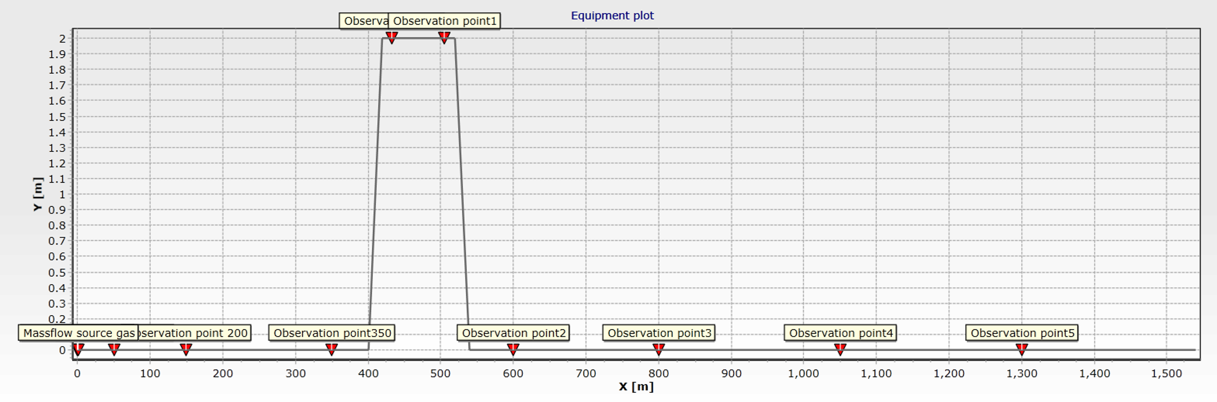
Pipe-11
Pipe-13
Pipe-3
Pipe-5
Pipe-7
Pipe-17
Pipe-19
Pipe-21
Pipe-23

Slide 2
Pipe-11
Pipe-13
Pipe-3
Pipe-5
Pipe-7
Pipe-17
Pipe-19
Pipe-21
Pipe-23

Slide 3
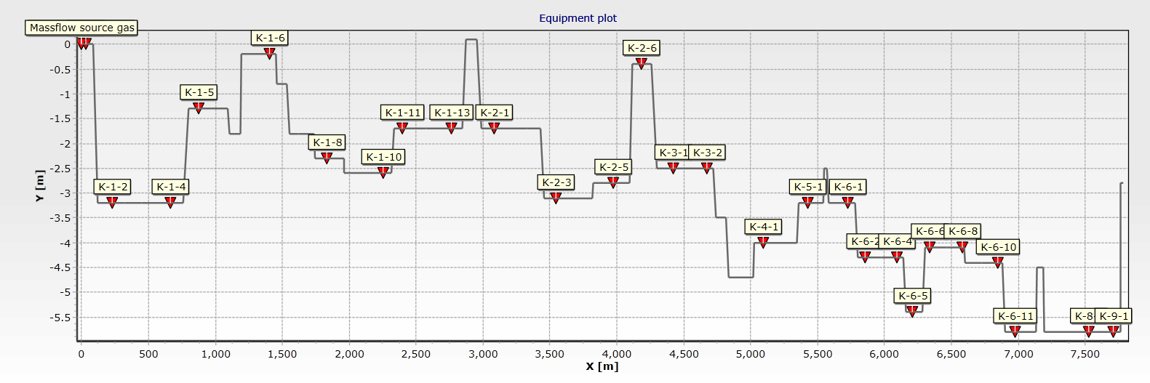
Pipe-2
Pipe-20
Pipe-41
Pipe-47
Pipe-61
Pipe-14
Pipe-38
Pipe-67
Pipe-79
Pipe-85
Pipe-75
Pipe-100
Pipe-92
Pipe-107
Pipe-29
Pipe-65
Pipe-34
Pipe-57
Pipe-6
Pipe-10
Pipe-52
Pipe-116
Pipe-89
Pipe-103
Pipe-96
Pipe-110
Pipe-118
Notes:
Pipe-2 Pipe-6 Pipe-10 Pipe-14 Pipe-20 Pipe-29 Pipe-34 Pipe-38 Pipe-41 Pipe-47 Pipe-52 Pipe-57 Pipe-61 Pipe-65 Pipe-67 Pipe-75 Pipe-79 Pipe-85 Pipe-89 Pipe-92 Pipe-96 Pipe-100 Pipe-103 Pipe-107 Pipe-110 Pipe-116 Pipe-118

Slide 4
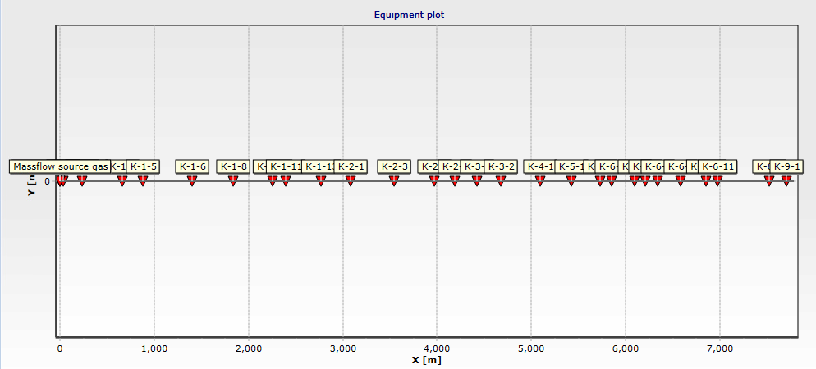
Pipe-2
Pipe-14
Pipe-20
Pipe-38
Pipe-41
Pipe-47
Pipe-61
Pipe-67
Pipe-75
Pipe-79
Pipe-85
Pipe-92
Pipe-100
Pipe-107
Pipe-116
Pipe-6
Pipe-10
Pipe-29
Pipe-34
Pipe-52
Pipe-57
Pipe-65
Pipe-89
Pipe-96
Pipe-103
Pipe-110
Pipe-118
Notes:
Pipe-2 Pipe-6 Pipe-10 Pipe-14 Pipe-20 Pipe-29 Pipe-34 Pipe-38 Pipe-41 Pipe-47 Pipe-52 Pipe-57 Pipe-61 Pipe-65 Pipe-67 Pipe-75 Pipe-79 Pipe-85 Pipe-89 Pipe-92 Pipe-96 Pipe-100 Pipe-103 Pipe-107 Pipe-110 Pipe-116 Pipe-118

